Slide 1
Military, Healthcare & Education Spending Analysis
Hanbyeol Choi
Individual Project 1
DATS 6401 – Visualization of Complex Data

Slide 2
DATASET
Raw data was obtained from following sources:
SIPRI Military Expenditure Database
World Bank Open Data
Analyzed at least top 10 nations from G-20
Time frame of data:
2011-2018
Data cleaning was conducted through Python
Data visualization was conducted through Google Visualization API

Slide 3
Purpose
Compare the spending data to that country’s GDP
Compare the education and health to the overall military spending of the country
Compare the per person education spending to the per person GDP
Compare the per person healthcare spending to the per person GDP
Compare the per person military spending to the per person GDP
Identify the fastest growing countries in healthcare and educational spending

Slide 4
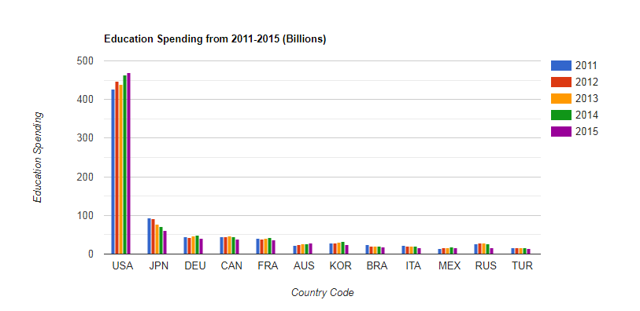
Education Spending

Slide 5
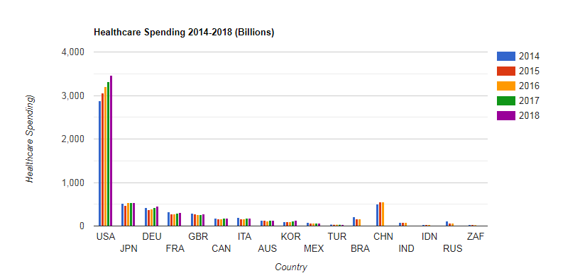
Healthcare Spending

Slide 6
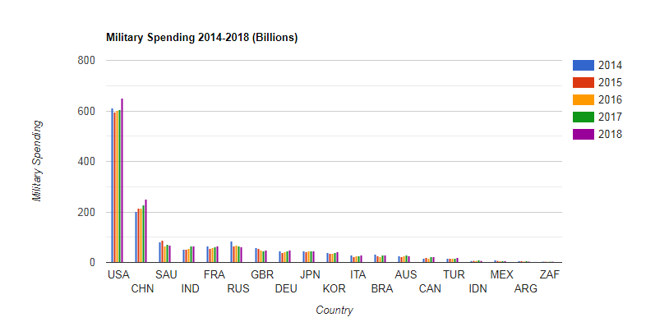
Military Spending

Slide 7
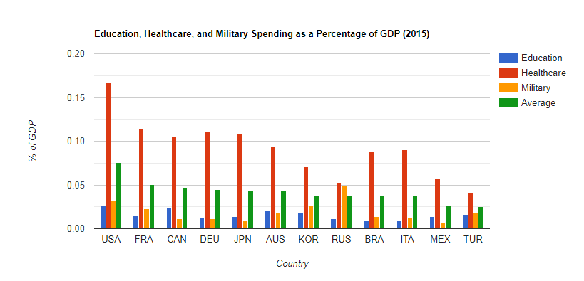
Spending Data to Country’s GDP

Slide 8
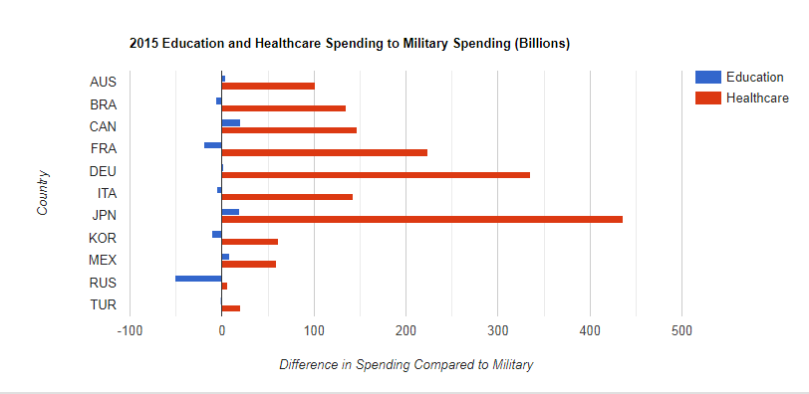
Education and Healthcare to Military Spending

Slide 9
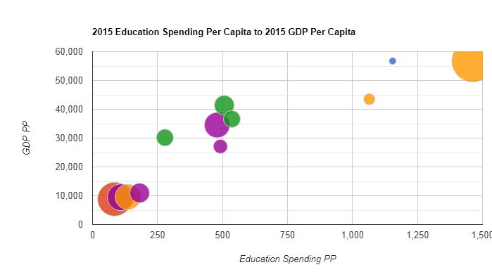
Education Per Capita to GDP Per Capita

Slide 10
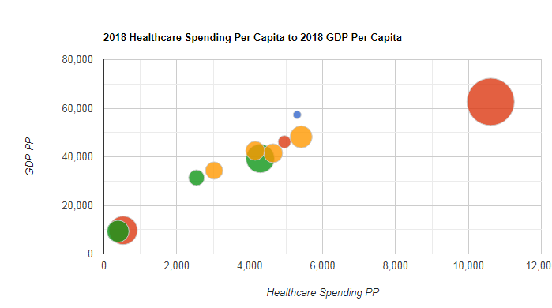
Healthcare Per Capita to GDP Per Capita

Slide 11
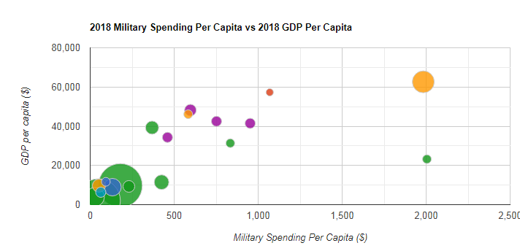
Military Per Capita to GDP Per Capita

Slide 12
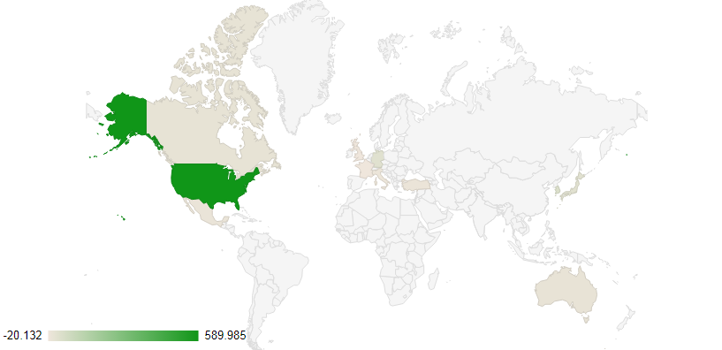
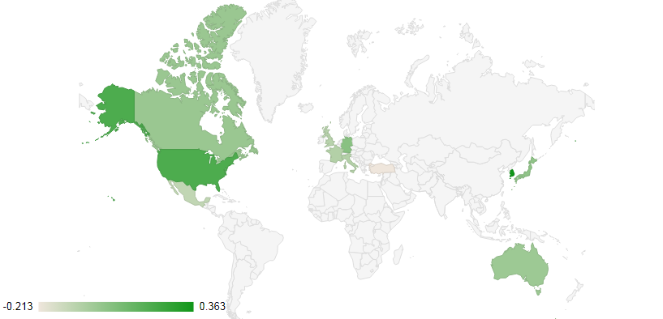
Change in Healthcare Spending

Slide 13
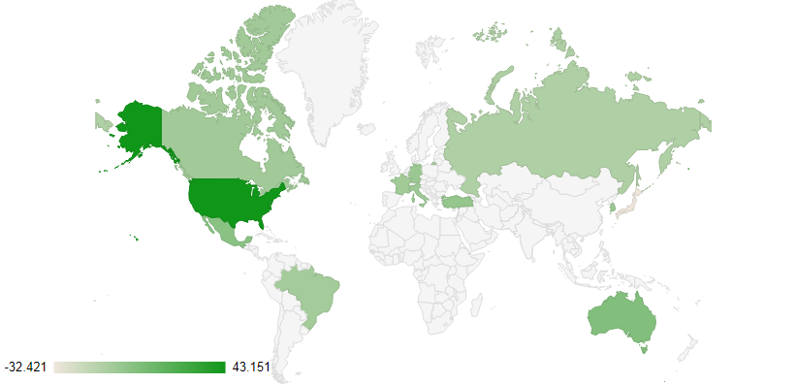
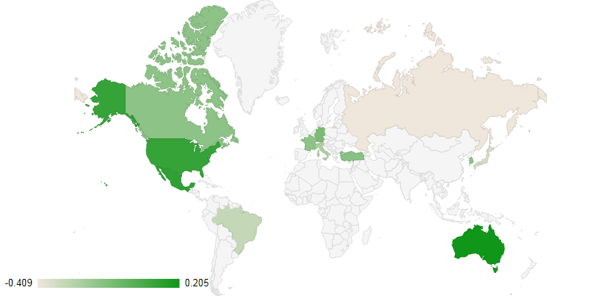
Change in Education Spending

Slide 14
Conclusion
USA had the most spending in all education, healthcare and military
All nations spent most on healthcare compared to education and military
USA had the most per capita education and per capita healthcare spending while Saudi Arabia had the most per capita military spending in 2018
Fastest growing country in education spending was USA with 43.15billion from 2011-2015. Japan spent the least with -32.42 billion from 2011-2015
Based on percentage, Australia had the most increase (20.46%) and Russia with the least (-40.90%)
Fastest growing country in healthcare spending was USA with 589billion from 2014-2018 United Kingdom spent the least with -20.13billion from 2014-2018
Based on percentage, South Korea had the most increase (36.3%) and Turkey with the least (-21.25%)

